Slide 1

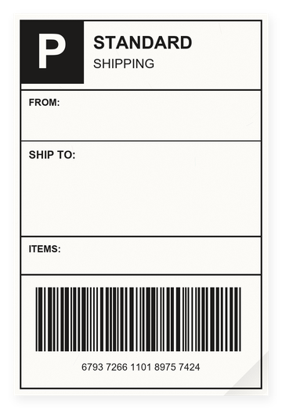


packing
an order
[Your shop]
Everything blue is a guide. Delete it before you download.
Notes:
Slide 1. Hook. Swap in a photo of you picking the order. Edit [your shop] on the label.

Slide 2
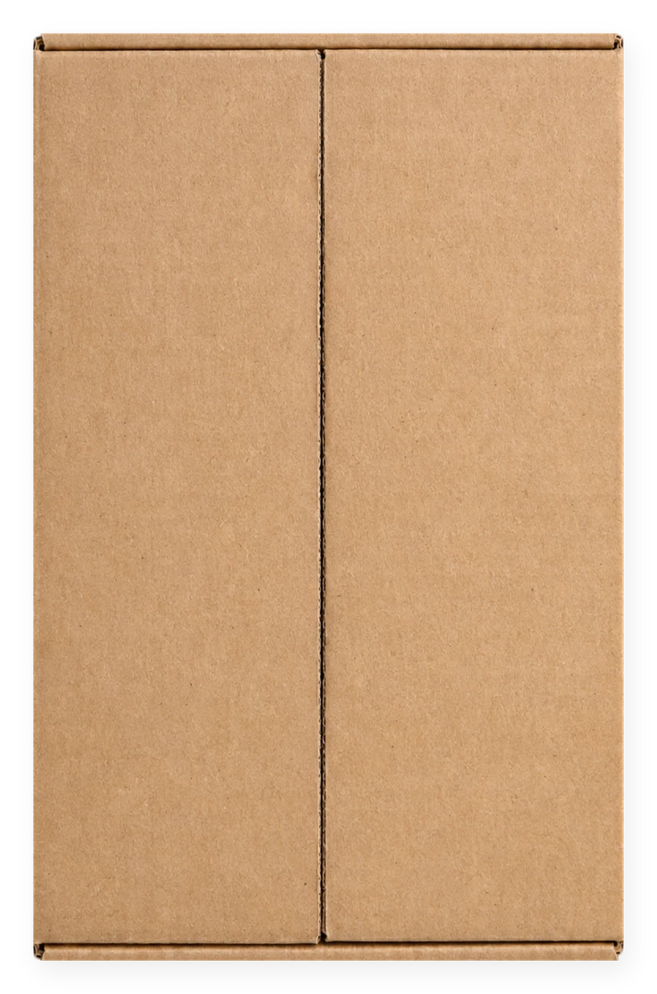



[ever wondered how
your order is packed?]
[watch me pack it]
Notes:
Slide 2. Second hook: Instagram often shows a carousel starting on slide 2, so this one works as a cover on its own. No photo needed. Edit both [bracket] lines.

Slide 3



the goods
go in first
Notes:
Slide 3. Swap in a photo of your product going into the box.

Slide 4


+ a little
padding
Notes:
Slide 4. Swap in a photo of the padding going in.

Slide 5





a little
extra
Notes:
Slide 5. Swap in a photo of the extras you add (a note, tissue, a sticker).

Slide 6

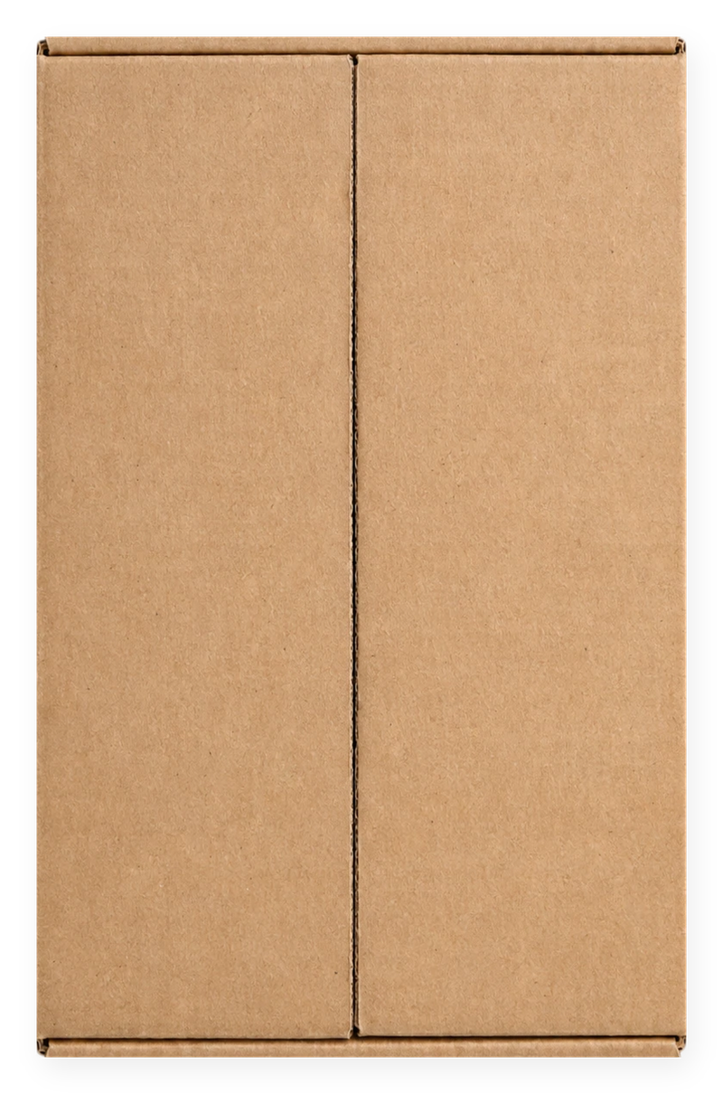

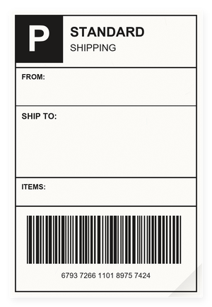
sealed +
on its way
[Your shop]
Notes:
Slide 6. No photo needed. Edit [your shop] on the label.

Slide 7

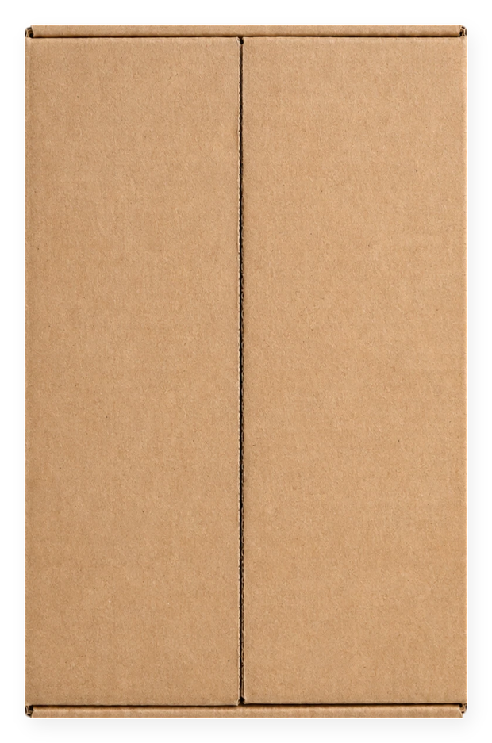
[Product name]
comment "[KEYWORD]"
Notes:
Slide 7. Type your product name and keyword. Caption to start from (CTA in the first two sentences, 3 hashtags): Comment [KEYWORD] and I will send you [the link]. [One line of real context: who it helps or how you use it.] #[tag] #[tag] #[tag]

